Slide 1

Team Details
Team name: Hack Verse
Team leader name: Rohini Matha
Problem Statement: Lack of unified healthcare access

Slide 2

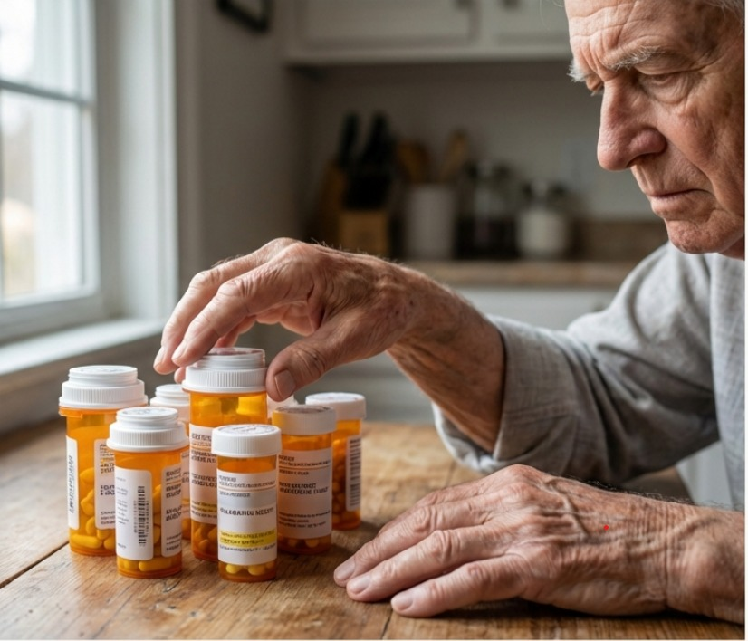
BRIEF ABOUT THE SOLUTION AND PROBLEM STATEMENT ADDRESSING
Problem:
Healthcare services are scattered across multiple platforms, making it difficult for users to find doctors, book appointments, and access medical information efficiently.
Solution:
HealthConnect+ solves fragmented healthcare access by bringing all essential health services into one unified platform.

Slide 3
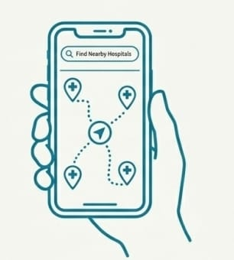
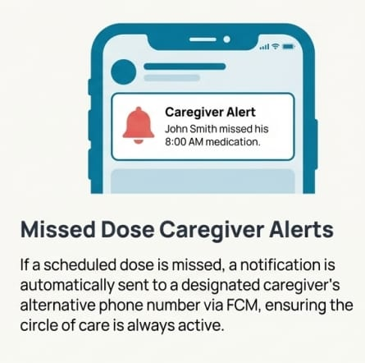
Opportunities
Unlike traditional hospital apps or scattered health portals, HealthConnect+ unifies multiple healthcare services into a single platform — appointments, doctor search, emergency help, and medical information — all in one place.
Many existing apps focus on just one aspect (e.g., booking appointments or viewing doctors), but HealthConnect+ offers an integrated solution for all healthcare needs.
By centralizing services, the platform reduces the time and effort users spend searching for healthcare options.
It eliminates confusion caused by multiple platforms and makes healthcare access efficient, fast, and user-friendly.
Users can find doctors, book appointments, and access emergency or health information seamlessly, all through one unified platform.

Slide 4
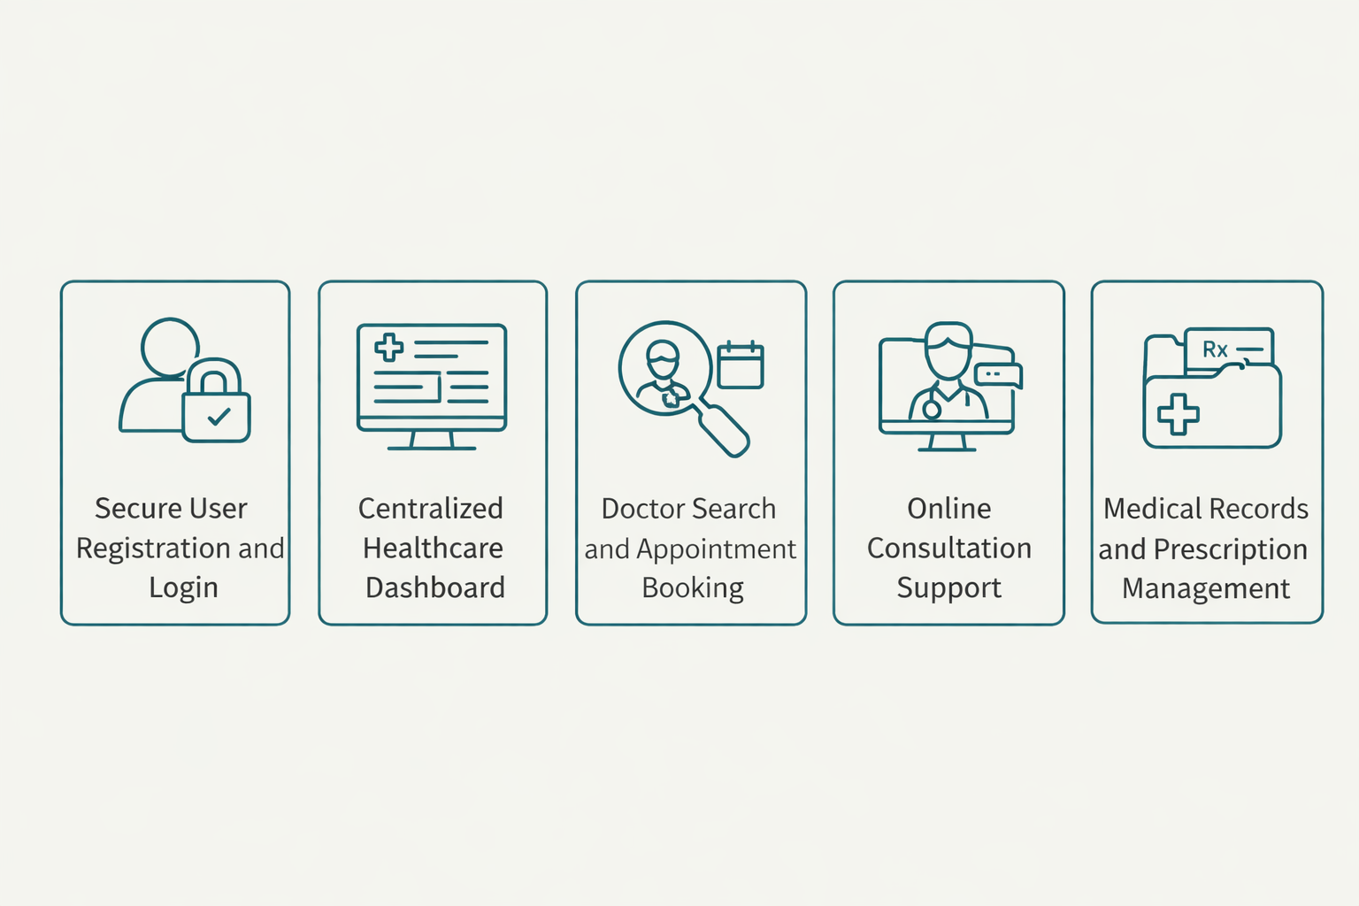
List of features offered by the solution

Slide 5
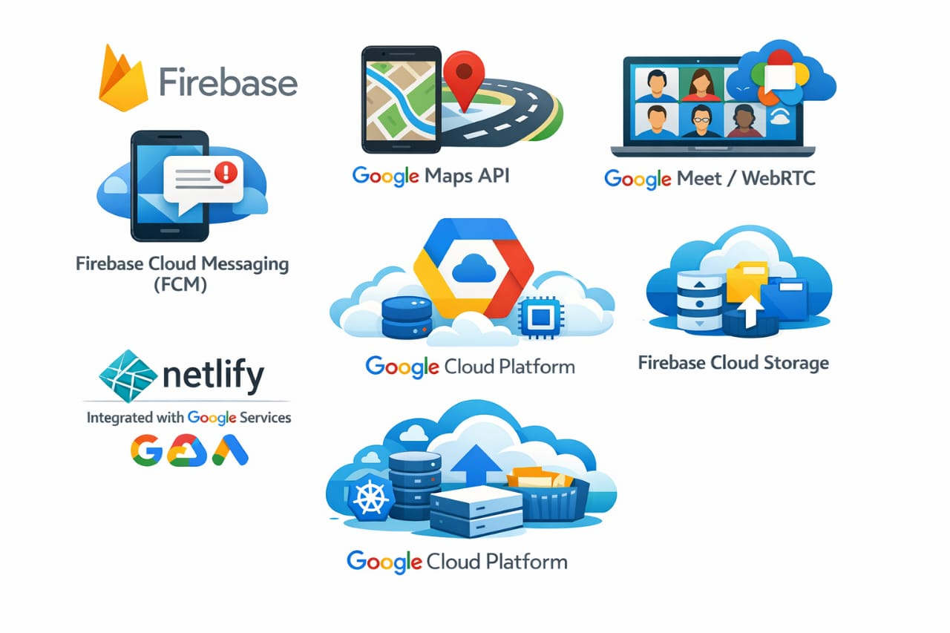
Google Technologies used in the solution

Slide 6
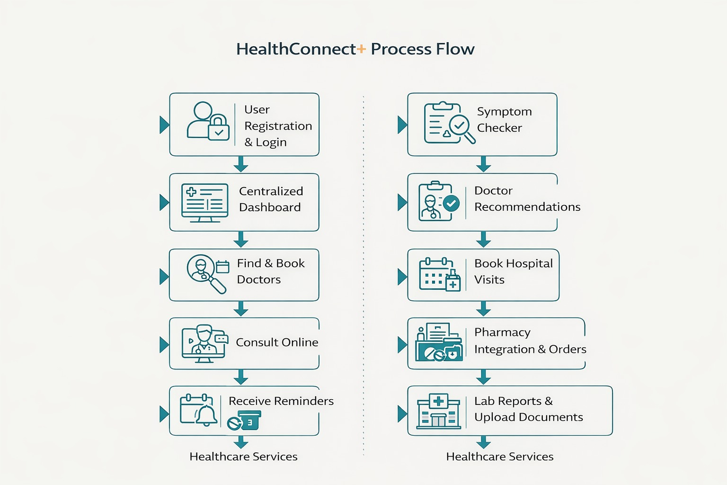
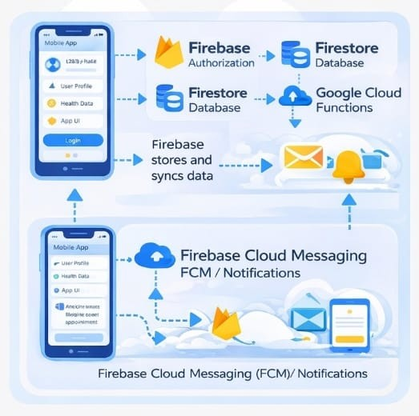
Process flow diagram : Architecture of the proposed solution:

Slide 7
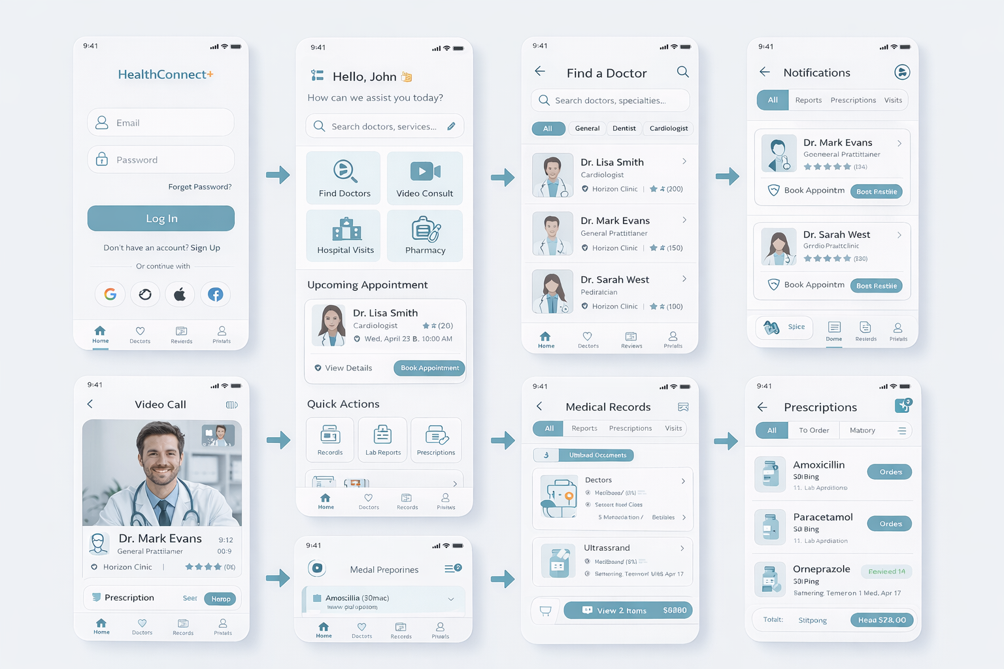
Wireframes/Mock diagrams of the proposed solution (optional)

Slide 8
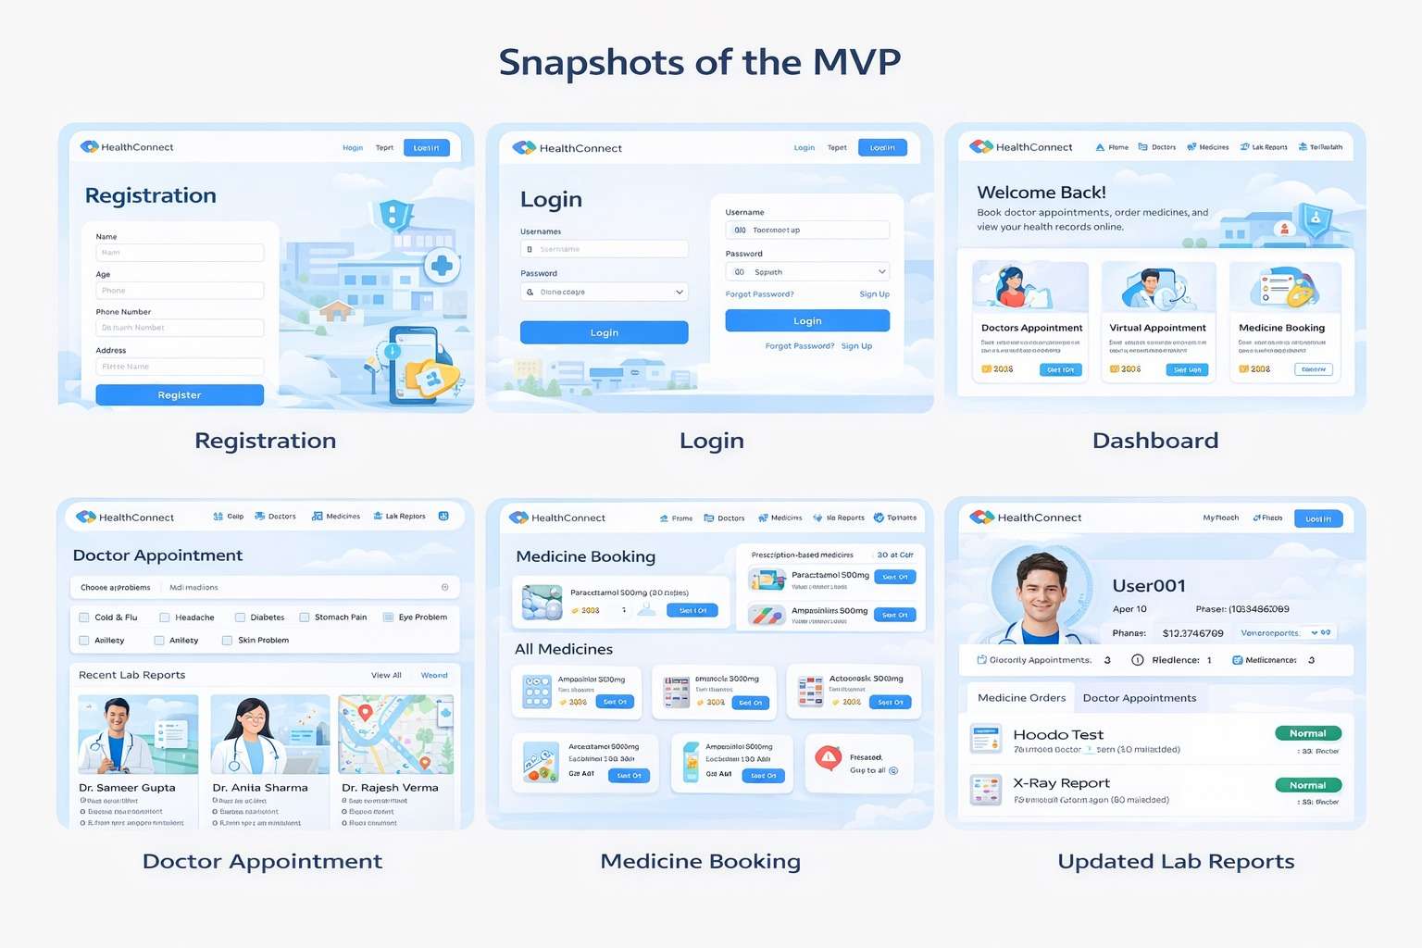
Snapshots of the MVP Additional Details/Future Development (if any)
Automatically recommend the most suitable doctor with higher accuracy.
Text-to-speech for prescriptions and reports.
Enable ambulance booking through location tracking.
Integration with Wearable & IoT Devices
Add an Emergency SOS button
AI-powered chatbot

Slide 9
Provide links to the project:
GitHub Public Repository: https://github.com/rgnaidu/Healthconnect-plus
Demo Video Link (3 Minutes): https://youtu.be/DdPlqgoVIV0?si=1Xdvj4zip87Gggdf
MVP Link: https://healthconnect-plus.netlify.app/#/

Slide 10

Thank you!

